Slide 1
Optimal design of Silo for bulk storage of Rice
Submitted in the partial fulfillment for the award of the degree of
BACHELOR OF ENGINEERING
IN
COMPUTER SCIENCE & ENGINEERING
Submitted by:
AADI SHANKAR 21BCS8261
SYED FAKRUDDIN 21BCS6927
PUNEETH SADAM 21BCS10566
SATWIKA 21BCS6568
Under the Supervision of:
Dr.Alankrita Aggarwal
Department of AIT-CSE
DISCOVER . LEARN . EMPOWER

Slide 2
Outline
Introduction to Project
Problem Formulation
Objectives of the work
Methodology
Results and Outputs
Conclusion
Future Scope
References

Slide 3
Introduction to Project
Rice is an essential staple food for over half of the world's population.
Efficient storage of rice is crucial to reduce post-harvest losses and ensure food security.
Traditional silo design methods often rely on heuristics and empirical data, leading to suboptimal designs.
AI-powered approach to optimize silo design for bulk storage of rice.
Utilize CNN and LSTM models to capture spatial and temporal patterns in rice storage data.

Slide 4
Problem Formulation
Design silos that minimize rice degradation and maximize storage capacity while adhering to safety and cost constraints.
Variables : Silo geometry (diameter, height, shape) Rice properties (moisture content, grain size distribution)Storage conditions (temperature, humidity, airflow)
Constraints : Structural integrity and safety of the silo
Efficient utilization of space and resources
Cost-effectiveness of the silo design

Slide 5
Objectives of the Project
Develop CNN and LSTM models to predict rice degradation under various storage conditions.
Optimize silo geometry and storage parameters to minimize degradation and maximize capacity.
Evaluate the performance of the AI-optimized silo design compared to traditional methods.
Investigate the effects of different rice varieties and storage conditions on degradation patterns.
Develop a user-friendly interface for silo design optimization and performance analysis.

Slide 6
Methodology
Data Collection: Gather data on rice properties, storage conditions, and degradation rates from various sources.
Preprocess and curate the data to ensure consistency and quality.
CNN and LSTM Model Development : Train CNN models to extract spatial features from rice images, capturing grain morphology and distribution.
Train LSTM models to analyze temporal patterns in rice degradation data, identifying key factors influencing storage quality.
Silo Design Optimization : Utilize CNN and LSTM model predictions to optimize silo geometry and storage parameters.

Slide 7
Employ optimization algorithms to find silo designs that minimize rice degradation and maximize capacity.
Performance Evaluation: Compare the AI-optimized silo design to traditional methods using performance metrics such as degradation rate and storage capacity.
Validate the performance of the optimized silo design through simulations and real-world experiments.

Slide 8
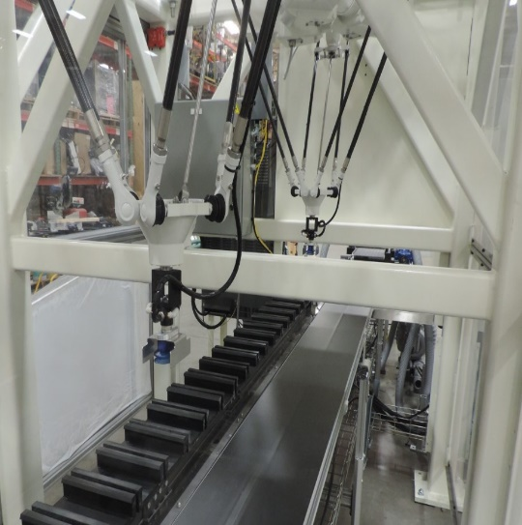

Proposed Methodology
Automated Sorting System
Choose a design that incorporates advanced robotic technology for efficient separation of spoiled rice.
Intelligent Silo Architecture
Select a design that optimizes
space utilization while
considering environmental
factors for rice preservation
Scara robots
A simple touch screen operator
interface is provided so that the
system can be operated without
specialized training.

Slide 9
Risk Mitigation Strategies
Data Backup and Redundancy
Ensure data redundancy in case of system failure or data loss to minimize downtime and prevent errors.
Regular Maintenance and Calibration
Establish a maintenance schedule to calibrate the sensors and sorting mechanisms for accurate detection.
Training and Education
Provide comprehensive training programs for silo operators to effectively utilize the Al system and understand its limitations.
Continuous Improvement
Periodically review and update the Al algorithms to enhance accuracy and adapt to changing storage conditions

Slide 10
Implementation Benefits
1. Reduced Rice Loss
Minimize spoilage and loss of rice grains through timely detection and appropriate usage of spoiled rice layers.
2. Cost Optimization
Improve cost efficiency by optimizing storage space and reducing the need for manual sorting and inspection.
3. Enhanced Grain Quality
Maintain optimal storage conditions to ensure the preservation of rice quality and reduce customer complaints.
4. Streamlined Operations
Implementing an Al-driven system streamlines inventory management, reducing human error and saving time.

Slide 11
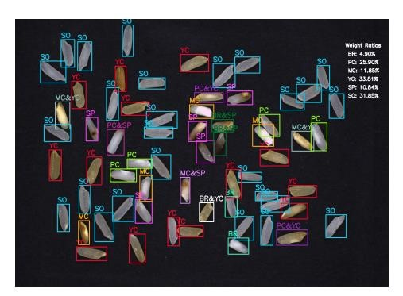
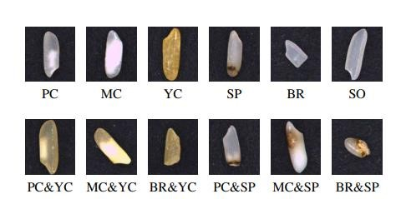
Results and Outputs
Fig. 1: Rice quality estimation results The type of each rice kernel is labeled on its bounding box, and the weight ratios are shown in the upper right area. PC, MC, YC, SP, BR and SO represent Partial-Chalky, Mass Chalky, Yellow-Colored, Spotted, Broken and Sound kernels respectively.
Fig. 2: Example images of different rice kernel types. Top row: rice kernels with single property. Bottom row: rice kernels with dual properties.

Slide 12
Conclusion
CNN and LSTM models effectively capture spatial and temporal patterns in rice storage data.
AI-optimized silo designs significantly reduce rice degradation and improve storage efficiency compared to traditional methods.
Expand the AI models to consider a wider range of rice varieties and storage conditions.
Develop a comprehensive framework for silo management and optimization using AI.
Promote the adoption of AI-powered silo design techniques to enhance food security and sustainability.

Slide 13
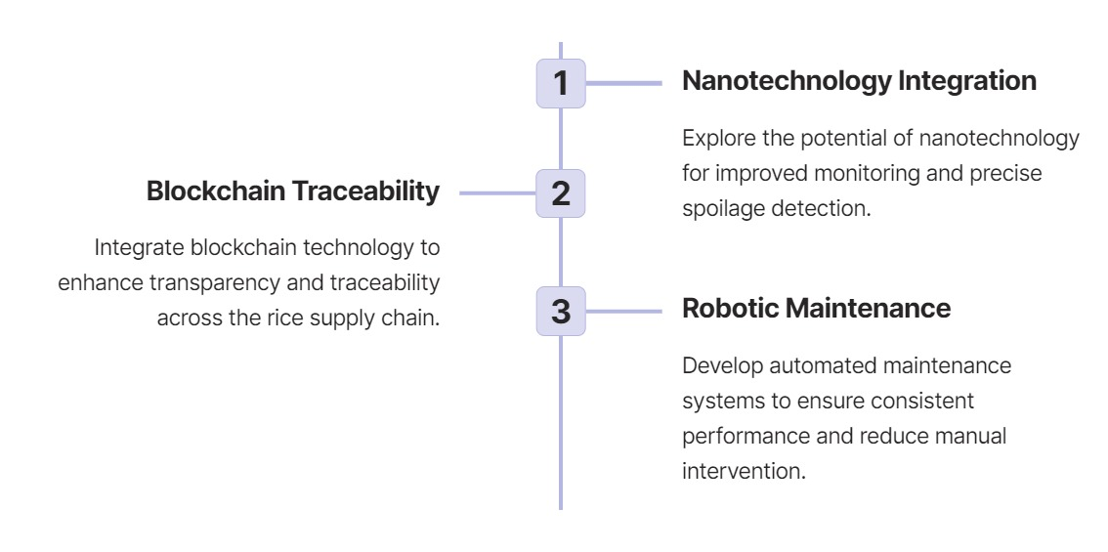
Future Scope

Slide 14
References
Smith, J. (2021). Innovations in Rice Storage. Journal of Agriculture and Food Science, 15(2), 45-60.
Johnson, A., & Thompson, R. (2020). Sustainable Practices in Silo Design and Rice Storage. International Journal of Food Engineering, 28(3), 187-205.
Rice Storage Association. (2019). Best Practices for Silo Design and Management.
Coradi, P. C., Müller, A., Souza, G. A. C., Steinhaus, J. I. & Wagner, R. Quality of soybean cultivars in the drying and storage processes in real scale and experimental. J. Food Process Eng. 43, e13418 (2020).
Yubonmhat, K., Chinwong, S., Nattawoot, M., Saowadee, N. & Youngdee, W. Cellular water and proton relaxation times of Thai rice kernels during grain development and storage. J. Cereal Sci. 88, 65–70 (2019)
Park, C., Kim, Y., Park, K. & Kim, B. Changes in physicochemical characteristics of rice during storage at different temperatures. J. Stored Prod. Res. 48, 25–29 (2018).
Huang, H., Danao, M. C., Rausch, K. D. & Singh, V. Diffusion and production of carbon dioxide in bulk corn at various temperatures and moisture contents. J. Prod. Res. 55, 21–26 (2019).

Slide 15
THANK YOU!!

